Slide 1
Opening Remarks
This is a technical topic that we will attempt to explain in terms that everyone can understand. There will be a lot of technical jargon, that you may have heard before. Hopefully you will build a basic understanding on what it means.
It is important to all of us, as we have all become dependent on the access to the Internet, and eMail that our home networks provide.
After all, you all drive cars, that are pretty darn technical. I’m sure that you have all built a basic understanding of how they work, if for no other reason than to be able to understand a mechanic when they tell you ‘this repair will cost you $$$’ !
I’m sure that some of you with an engineering background may feel that I am over-simplifying, or skimping on detail. Please understand that I feel it necessary to allow the non-engineering members to build a reasonable picture in their minds.

Slide 2
Home Network Security
by Mark R. Mach, CISSP

Slide 3

Mark R. Mach
Mark has almost forty years of education and experience in the management and application of Information Security and Technology
Chief Information Security Officer (CISO) at Certilytics, Inc.
Certified Information Systems Security Professional (CISSP)
Member of the International Information System Security Certification Consortium (ISC)2
Member of and Director at Large for the board of the International Information System Security Certification Consortium (ISC)2 Phoenix Chapter
Member of American Mensa
Background includes: information security, management, information technology and security governance, systems integration, systems administration, network administration, independent verification and validation (IV&V), software development, process development and improvement, and technical documentation
Studied Computer Science at Michigan Technological University
Served in the United States Navy

Slide 4
What is a Computer (or Data) Network?
“A computer (or data) network is a digital telecommunications network which allows nodes to share resources.”
–Wikipedia
If you’re connected to the Internet, using services from Cox or CenturyLink, or some other “ISP” (Internet Service Provider), you are a node connected to a computer network that spans the globe.
You will have a small piece of computer networking equipment, usually called, simply, a “router” or a “modem”, in your home. It manages all of this communication.
Your router is your front door to the world. It must be protected!

Slide 5
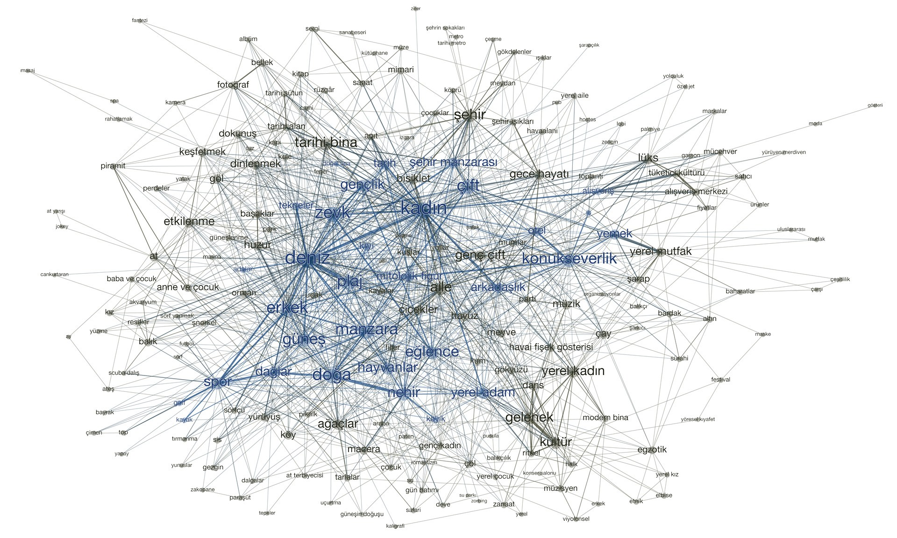
A Network

Slide 6
What’s a ‘network node’?
Before I dive into more detail, let me explain that any device connected to a network is called a ‘node’ on the network.
Your computer is a node on your home network. Your router is a node on your ISP’s network.
For this discussion, please keep in mind that when we talk about ‘computers on the network’, we also include any electronic device that you may use that communicates via your network with some other digital device. It’s easy to picture them as PCs talking to the Internet, but we must include mobile phones, tablets, printers, TVs, security cameras, refrigerators, emergency pagers and all of the IoT (Internet of Things) that are now coming ‘Internet enabled’.

Slide 7
Home Network

Slide 8
Identification of Network Nodes
When computers talk across a network:
They send data from one node to another, up and down the chain. They’re called ‘data packets’ (something like sentences).
A single message (like a web page) may include thousands of packets.
Each packet includes the ID of the sender and the ID of the recipient.
These node IDs are called ‘IP Addresses’
Every node must have an assigned IP Address to send and receive data.

Slide 9
IP Addresses
In order to hold a conversation with another node on a network your computer must have an IP Address.
An Internet Protocol (IP) address has four segments (bytes), generally designated by four numbers ranging from 0 to 255, separated by periods (dots).
For example, the address of the computer I am working on now, on my home network is: 192.168.1.3
IP addresses are unique, within the network where they reside. No two devices can use the same network address (an error will appear on both devices if this happens).
We’ve found that with the growth of the Internet, they need to double the size of the IP Address to handle all of the nodes.
(IPv4 from 1984 could only support 4.3 billion nodes → IPv6)

Slide 10
IP Address Assignment
IP addresses are either assigned permanently, by a management authority, or automatically, as needed by a Router (‘DHCP facility’).
A block of IP Addresses have been reserved for use within a ‘Private’ network, like the one established in your Home.
‘Public’ IP addresses are used outside your home and across the Internet
Your home router will assign private IP addresses for the devices within your home.
Your home router has a Public IP address assigned by your ISP (Cox, Centurylink, etc.), that it uses to talk to the outside – to the Internet.
You can see the public IP address that you are using by going to: https://whatismyipaddress.com

Slide 11
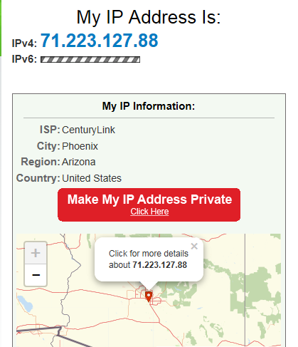
https://whatismyipaddress.com

Slide 12
Domain Name Services (DNS)
One final technology…
If all computers on the Internet have IP Addresses, and that’s how we communicate with that computer node, how is it we get to Amazon using www.amazon.com.
An important service, built into the Internet is a huge index of all web site (domain) names and their associated IP address.
Your router, with the help of this index (the DNS service) finds the IP address based on the name you type into your web browser.

Slide 13
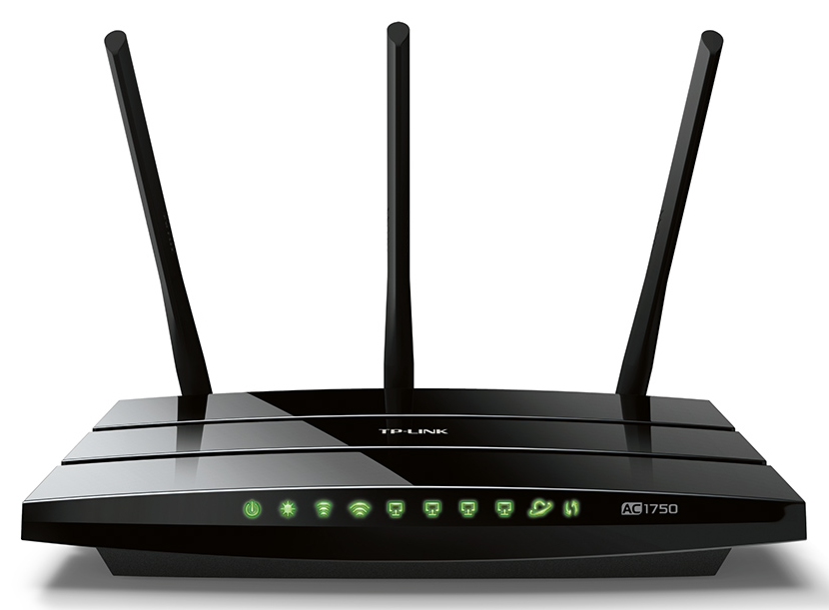
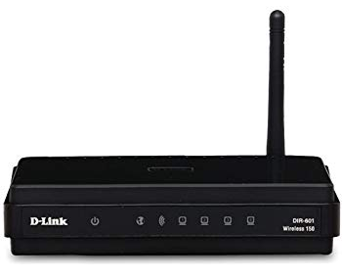
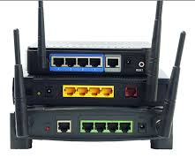
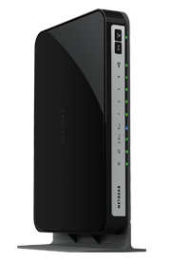
Home Routers

Slide 14
Your Home Router
The little black box that is connected to your telephone line (for CenturyLink) or your TV Cable (for Cox) handles all of your communication to the Internet.
Modem – a device that converts signals from telephone, human-speak or TV cable speak, to digital computer-speak, and back.) I won’t get into the difference between ‘analog’ and ‘digital’ communication. Just think of it like translating between English and Latin.
The modem may plug into your telephone line, your TV cable, or even connect to a satellite antenna.
WiFi Router a device that manages computer communication traffic (a traffic cop role) and allows computers to communicate over the airwaves. The Router and Switch work hand-in-hand, with the Router focusing on longer distance traffic (like to the Internet) and the switch focusing on local traffic (like within your home). These are called WANs (Wide Area Networks) and LANs (Local Area Networks)
Switch a device that allows multiple computers to share a single line in/out, remember the old ‘telephone ‘party lines’?
You may not pass data back-and-forth between multiple computers in your home, but you may very well be utilizing this facility with a printer in your house.

Slide 15
Your Home Router (cont.)
Services to include assigning IP Addresses, looking up Domain Names and IP Addresses and a Control panel for configuring your router.
Firewall a feature or device that enforces usage rules, for security purposes. The rules can define who and how computers can communicate with each other. This now-common facility is often overlooked (except by Security geeks)

Slide 16
Home Router Functions

Slide 17
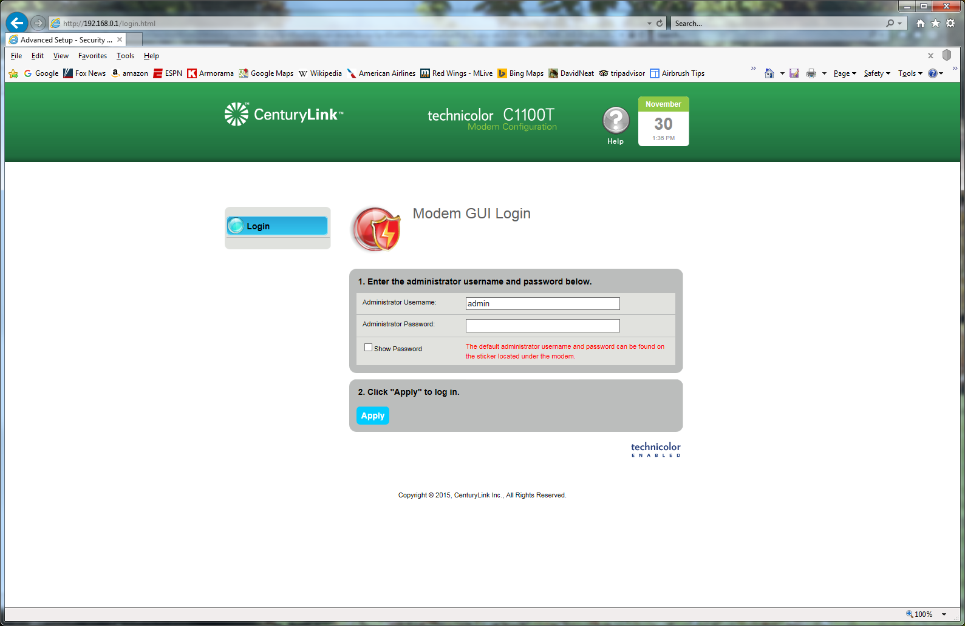
My Router Control Panel

Slide 18
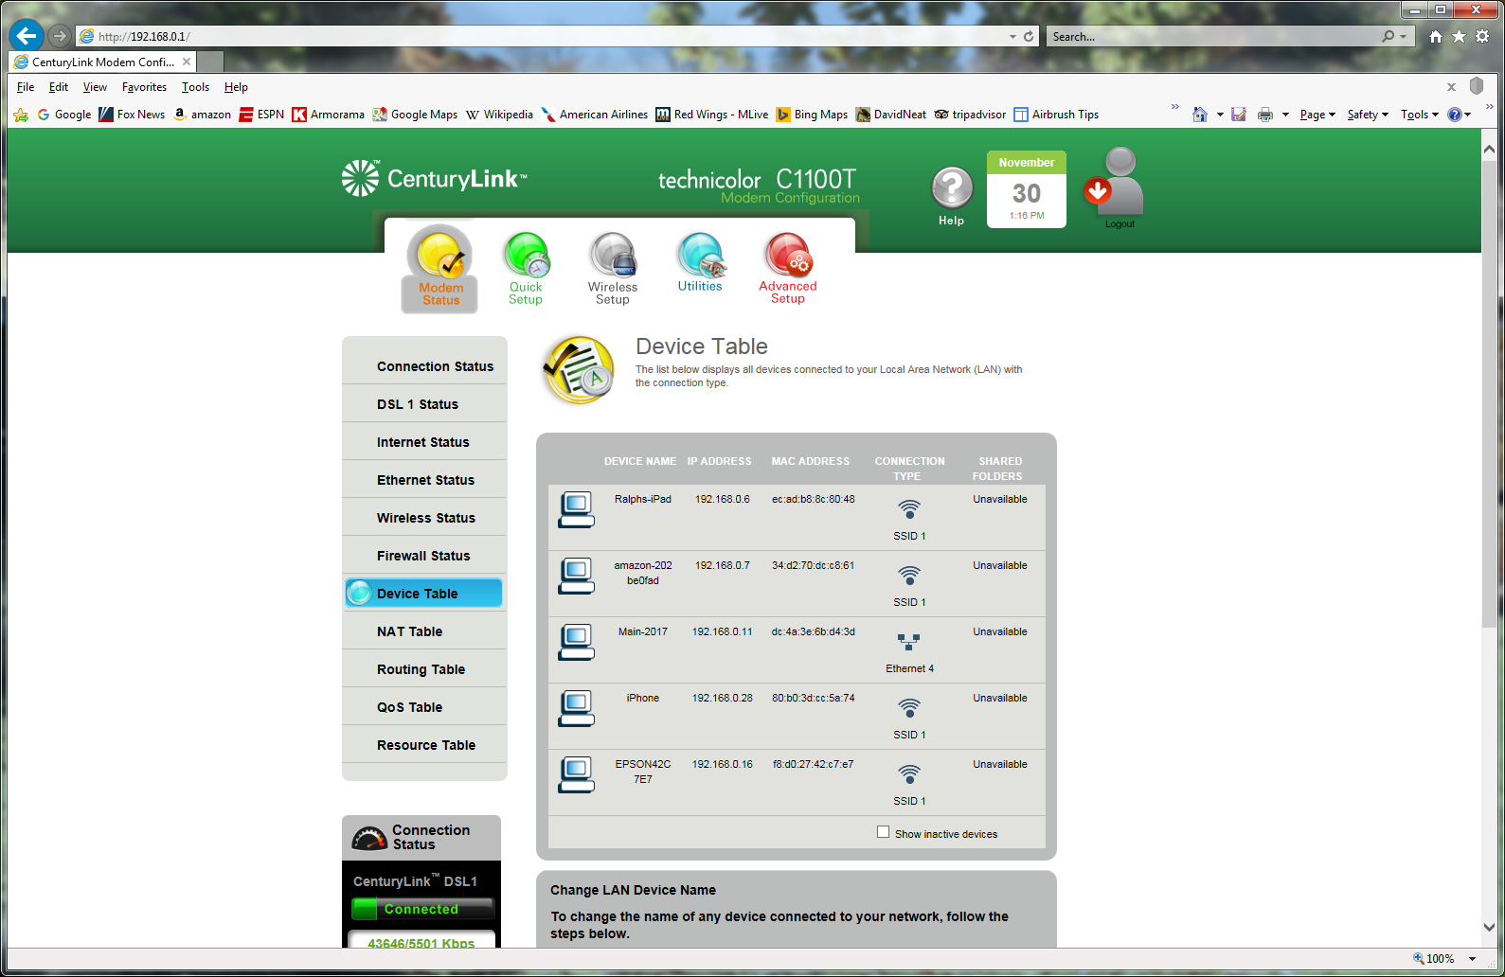
My Router Control Panel

Slide 19
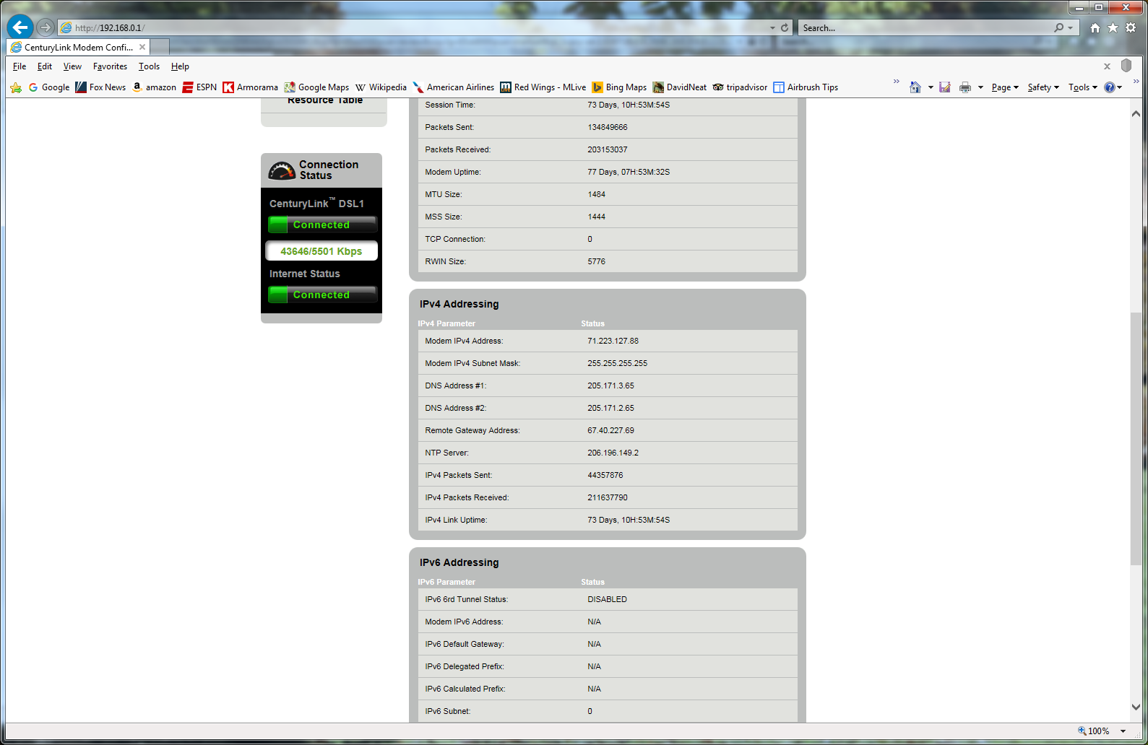
My Router Control Panel

Slide 20
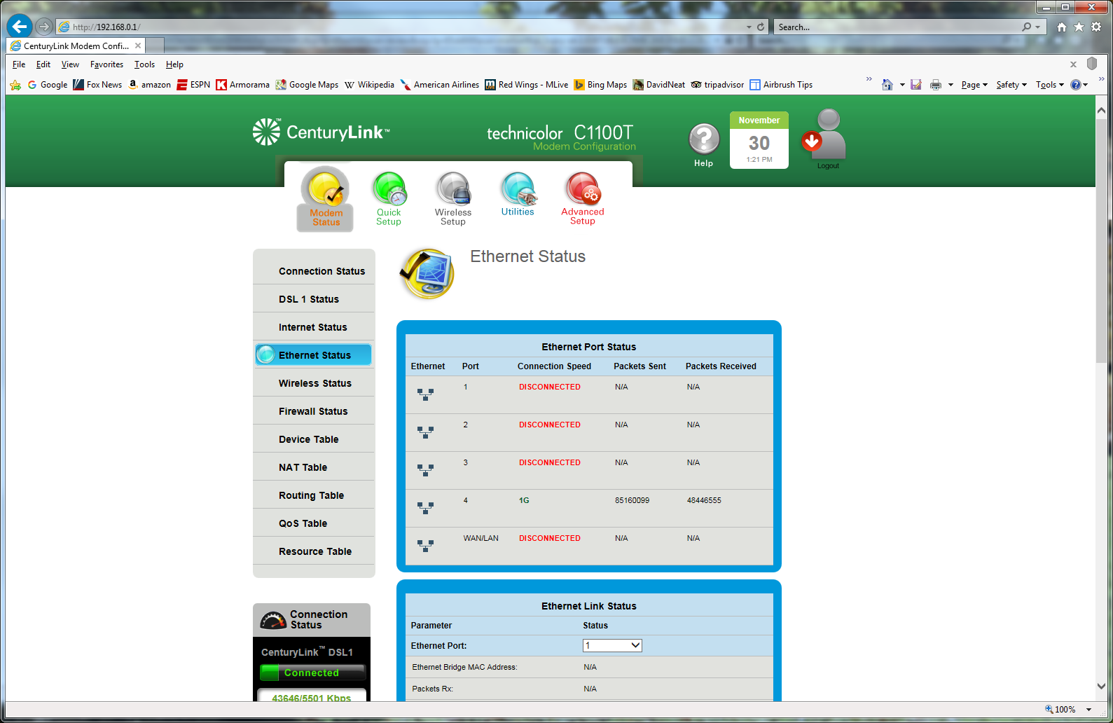
My Router Control Panel

Slide 21
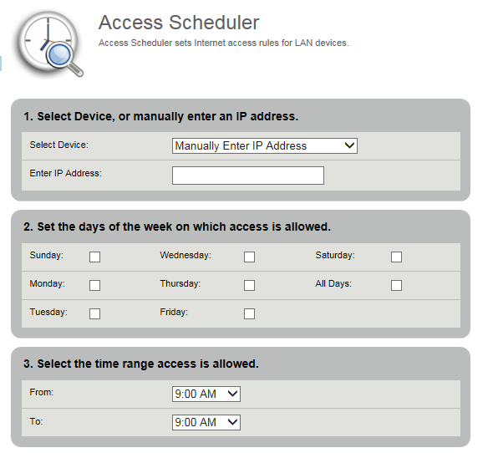
My Router Control Panel

Slide 22
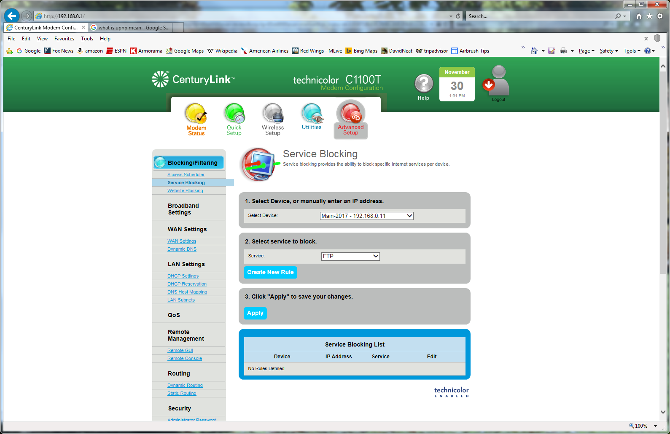
My Router Control Panel

Slide 23
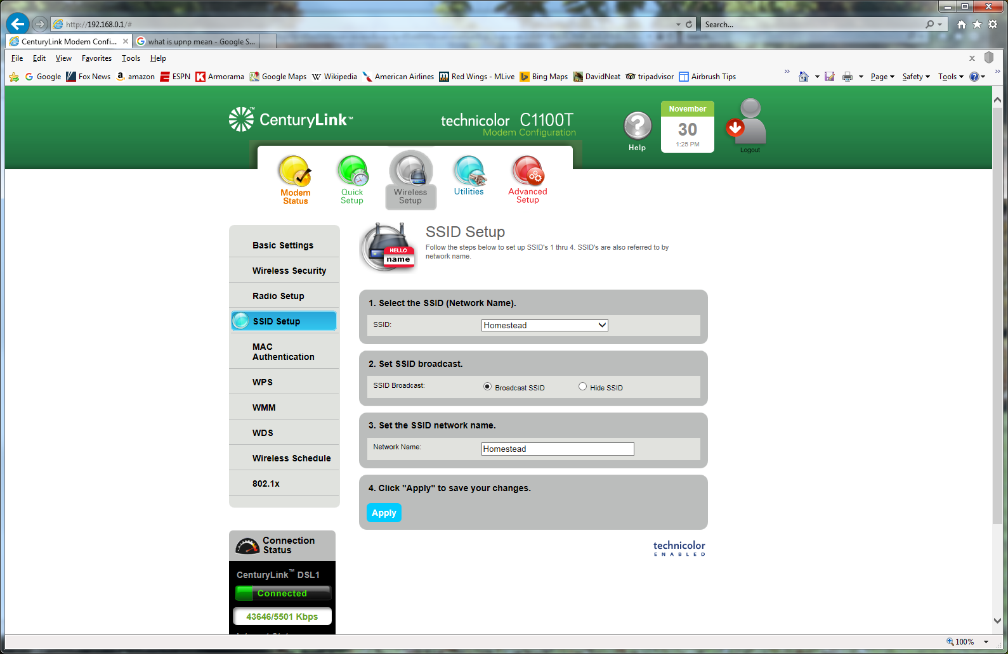
My Router Control Panel

Slide 24
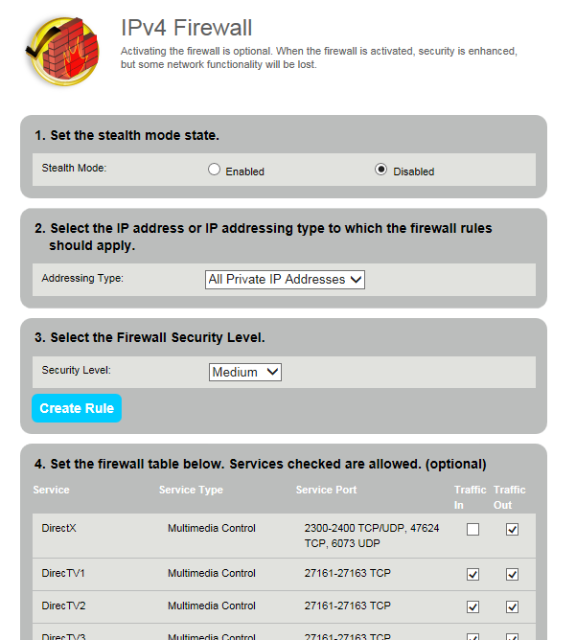
My Router Control Panel

Slide 25
Home Network Security Essentials

Slide 26
Network Firewall
If your router that connects you to your ISP does not have a firewall, then buy a separate firewall device for home use.
It should have stateful inspection (understands different types of transactions so it can intelligently accept incoming connections)
Set it to block EVERYTHING incoming by default.
If you need some incoming connections, you can add those as an exception to the ruleset.
It is generally a bad practice to open connections to your internal network, so avoid doing so. Sometimes, an application will require certain ports open to function properly, and you may have to make those exceptions.
When creating an exception, use rules that restrict the exception to the bare minimum needed. For example, if you connect to an audio conferencing server that requires UDP port 6000 to be open, then specify to the firewall that only the IP address from the conferencing server can connect to the specified host on UDP port 6000.
Keep the firmware/software on your home router/firewall up to date. Bookmark the web pages if you can get and install the firmware yourself.
For your home router that connects you to your ISP, you will generally need to get updates from your ISP, and they are notoriously slow at pushing out important updates. If you know there is a severe security vulnerability, call them, harass them, and tell them you will hold them liable if you are breached as a result of their negligence. (It has not worked yet for me, but good luck to you!)

Slide 27
Wireless Security
Change the name of your wireless network (SSID) to something personal
Password protect your wireless network.
No, really—password protect your wireless network, and use a strong password that cannot easily be guessed.
Use encryption on your wireless network, in this order of preference:
WPA2: the most secure of the protocols
WPA: not recommended, but it is better than nothing if WPA2 is not available
WEP: this is a weak encryption algorithm with known issues—do not use it if other encryption schemes are available. Upgrade your wireless access point if this is all it offers.
Type your password for guests on their devices if you want to grant them internet access—a guest wireless network would be best for them (provides internet access but not access to the same network as your personal devices).
Use discretion before giving out wireless access in your home. My wife (before we were married), provided her wireless password to her children's friends, and one of them was using BitStream to pirate software. She received a letter from her ISP threatening to suspend her ISP services as a result.
Have actual trust before providing access to your home network.

Slide 28
Endpoint (Computer) Security
Run a host-based firewall. Windows and Macintosh both have them built into the operating system.
You can open services as required, but be selective like you are with your network-based firewall. You might need to open up some services for scanners, printers, or other devices on the local network.
Restrict permissions appropriately. It might be convenient to have a file share on one device so you can access your financial records on all other computers in your house, but ensure that only you can access those files. Set your permissions accordingly.
Use anti-malware (anti-virus) software. Don’t consider running without it.
Use strong passwords. My password is always fourteen characters or longer, with lots of complexity.

Slide 29
Beware Of Social Engineering
Computer criminals find it harder and harder to break into computers, and are resorting to hacking the human instead of the machine. It’s generally an easier target.
Emails or web pages that announce that you won a free iPad are usually trying to get you to click on something that you shouldn’t.
Hover your mouse pointer over links in emails or on web pages before you click on them to see where they will take you. If the description says “target.com" and the URL that appears when you hover over it is not target.com, then there is probably a huge risk in following it.
Microsoft does not monitor your system remotely and help you when you have issues or they suddenly detect malware. Don’t provide anybody remote access to your system, even if they claim that they are trying to help. Phone calls like these are a scam to break into your computer.
Don’t trust anybody that calls you—they can claim to be somebody they are not, and even use a phony caller ID. Call them back at published numbers for their organization (not numbers that they provide you).
Don’t use USB thumb drives that you find laying around. They may be infested with malware waiting for somebody to plug it in.
Be skeptical!

Slide 30
Home Networking/Computing Physical Security
Do not leave any important computing assets outside, in an open garage, or anywhere that people can easily access it without your knowledge.
Cable runs are best done within walls or a secure space. A wired connection to a security camera on your network is easily disabled if it is stapled to the outside of your wall.
Don’t use untrusted equipment. That thumb drive sitting in the parking lot may be free, but it could be a trap that somebody left there, hoping that you would use it resulting into a malware infestation of your computer.
Encrypt your computer hard drive. If your computer is stolen, it is what stands between keeping your data secure, and allowing somebody else to access it. There are third party tools to allow this, and it is a built-in feature of some versions of Windows, and all up to date versions of Mac OS.
While you’re at it, make sure that your mobile phone is encrypted and password protected. If somebody finds it and it is wide open, they have a key into your home wireless network, along with your name, address, and probably more personal information than you want to provide.

Slide 31
General Security Tips
Update your software regularly—at least every month.
Remove unnecessary services and software. If you don’t need something, don’t keep it installed on your PC.
Adjust factory-default configurations on software and hardware. Do not leave the default admin account and password on your router or firewall—change them to use a well chosen password!
Regularly back up your data.
Improve your password security. You have had presentations on this topic before, so this is just a reminder to use long, complex passwords.
If you have a techie friend receptive to answering questions and helping out, use them as a resource to answer questions if needed.

Slide 32
The Bottom Line
Understand your home network. Knowledge is power, and the better you understand it, the better you can safeguard it.
Use common sense. If something doesn’t feel right, it probably isn’t.
Be skeptical about people wanting to access your computer, or wanting you to click on links on web pages or emails. Don’t let them convince you to click by appealing to your motivators: greed, willingness to be helpful, not wanting to defy authority figures, etc. Social engineers are experts at manipulating people, and will use every trick in their book to do so.

Slide 33
Happy Networking!

Slide 34
Questions?

